Slide 1

Karthick kumar S project
Namma kadai

Slide 2
First need to create a user
If the user is created the good to jump on dashboard
You can choose whatever actions need to do in the dashboard

Slide 3
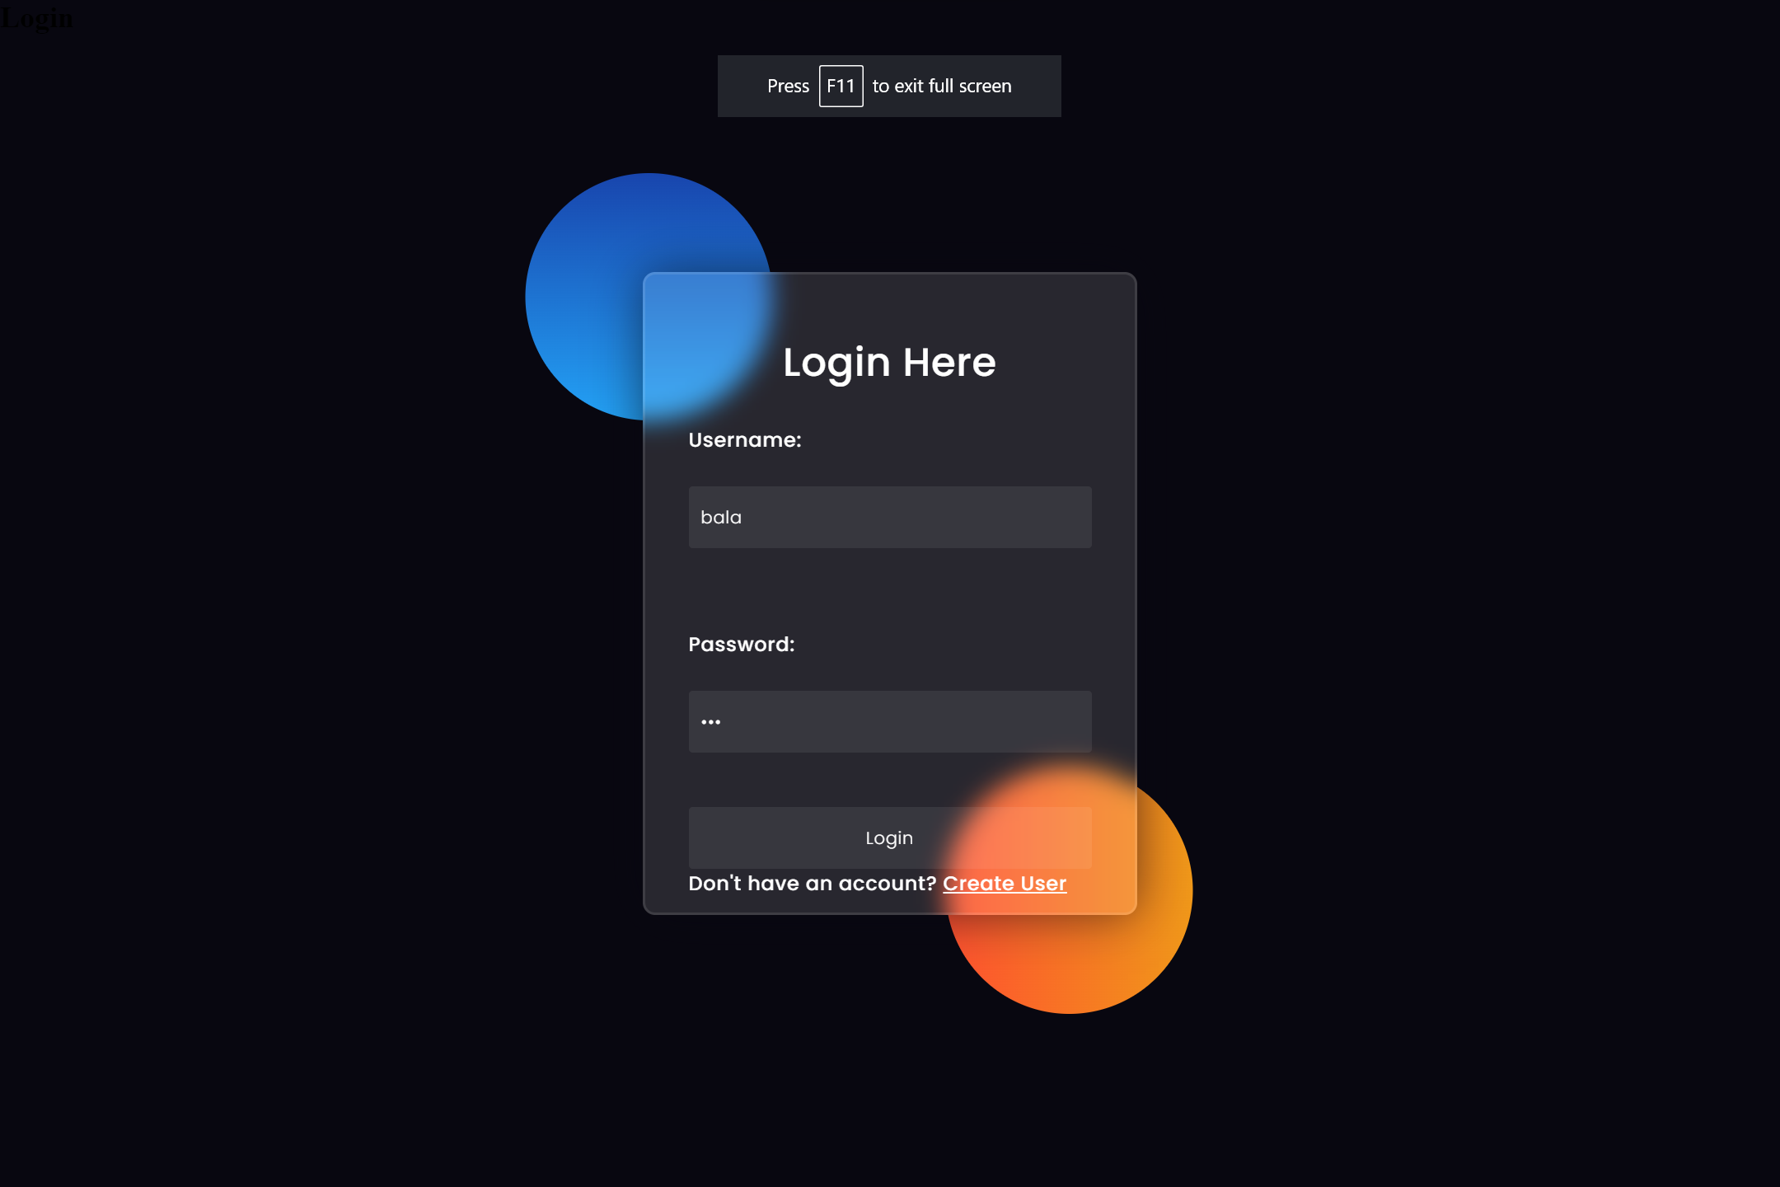

Slide 4
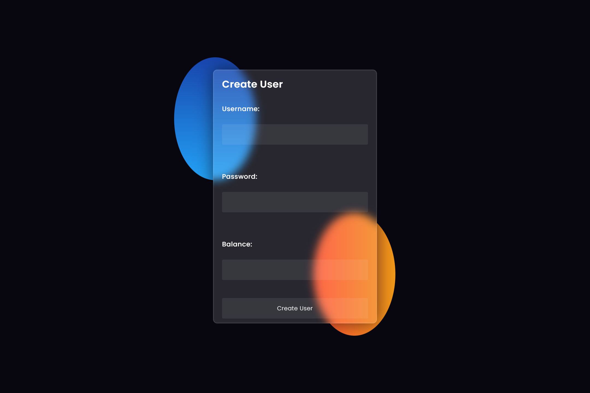

Slide 5
DASHBOARD

Slide 6


Slide 7
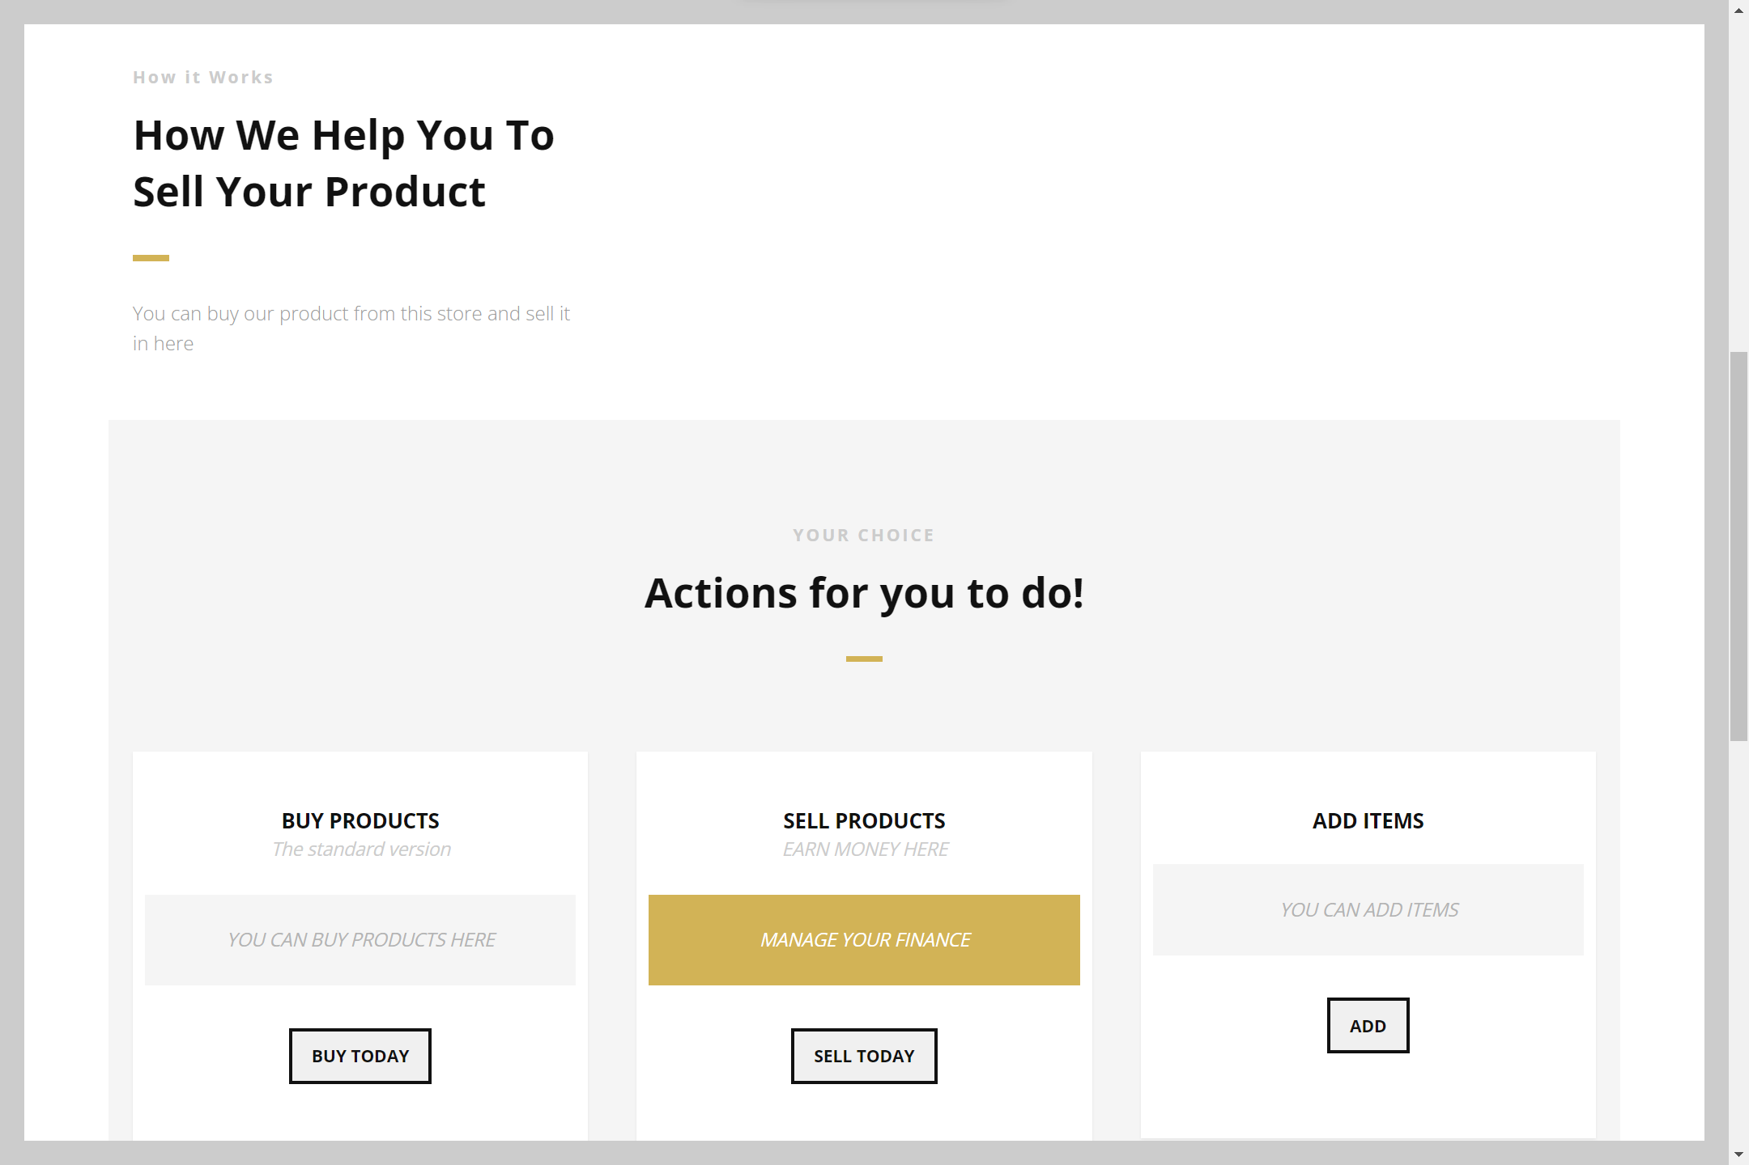

Slide 8
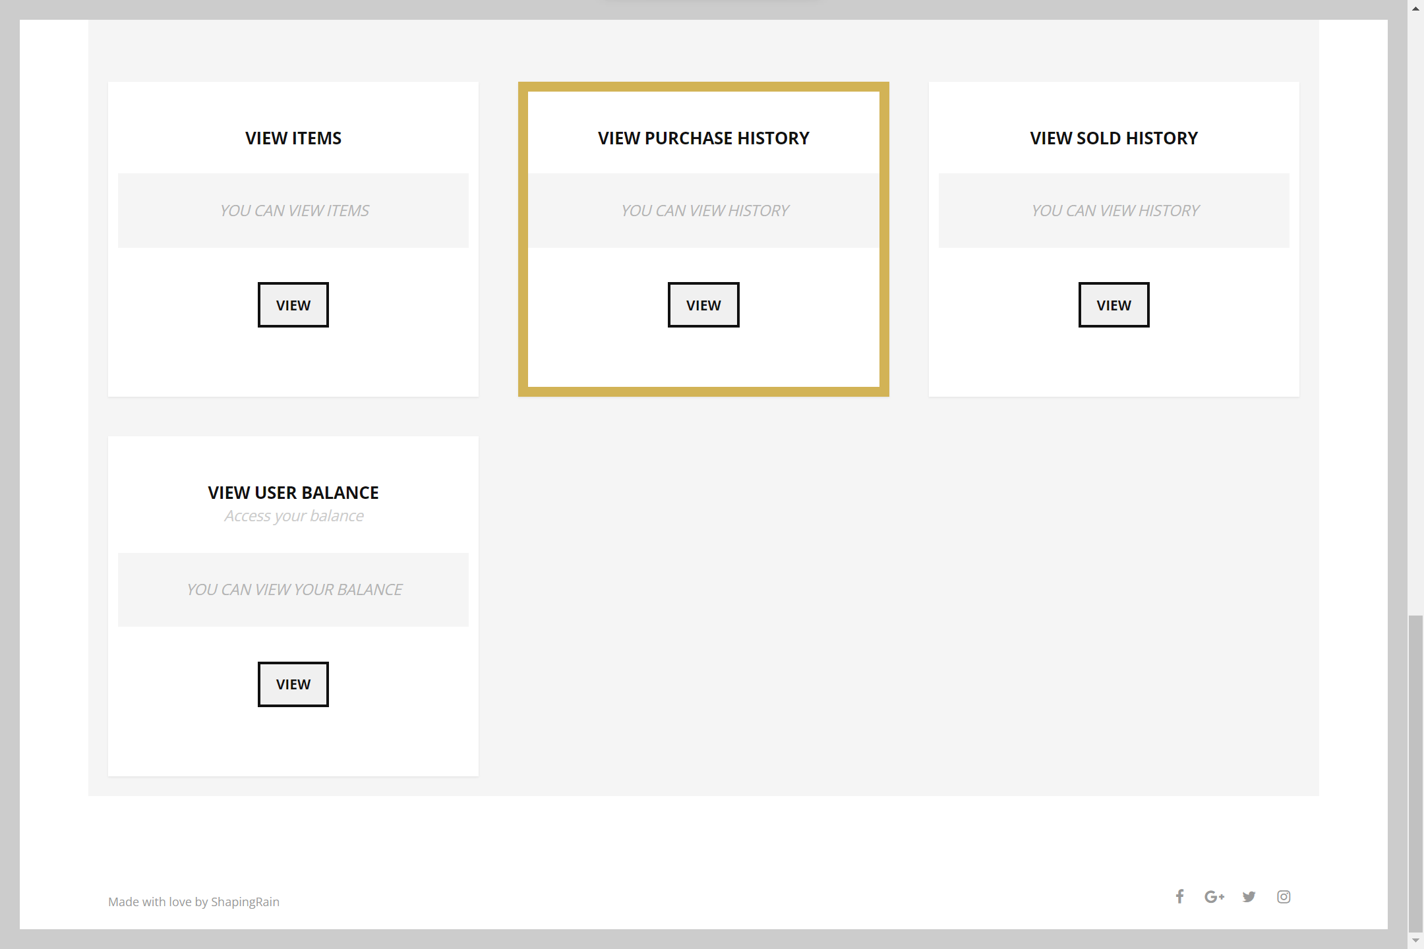

Slide 9
On the dashboard you can perform many actions
Select buy products
Click calculate
Click go to dashboard

Slide 10
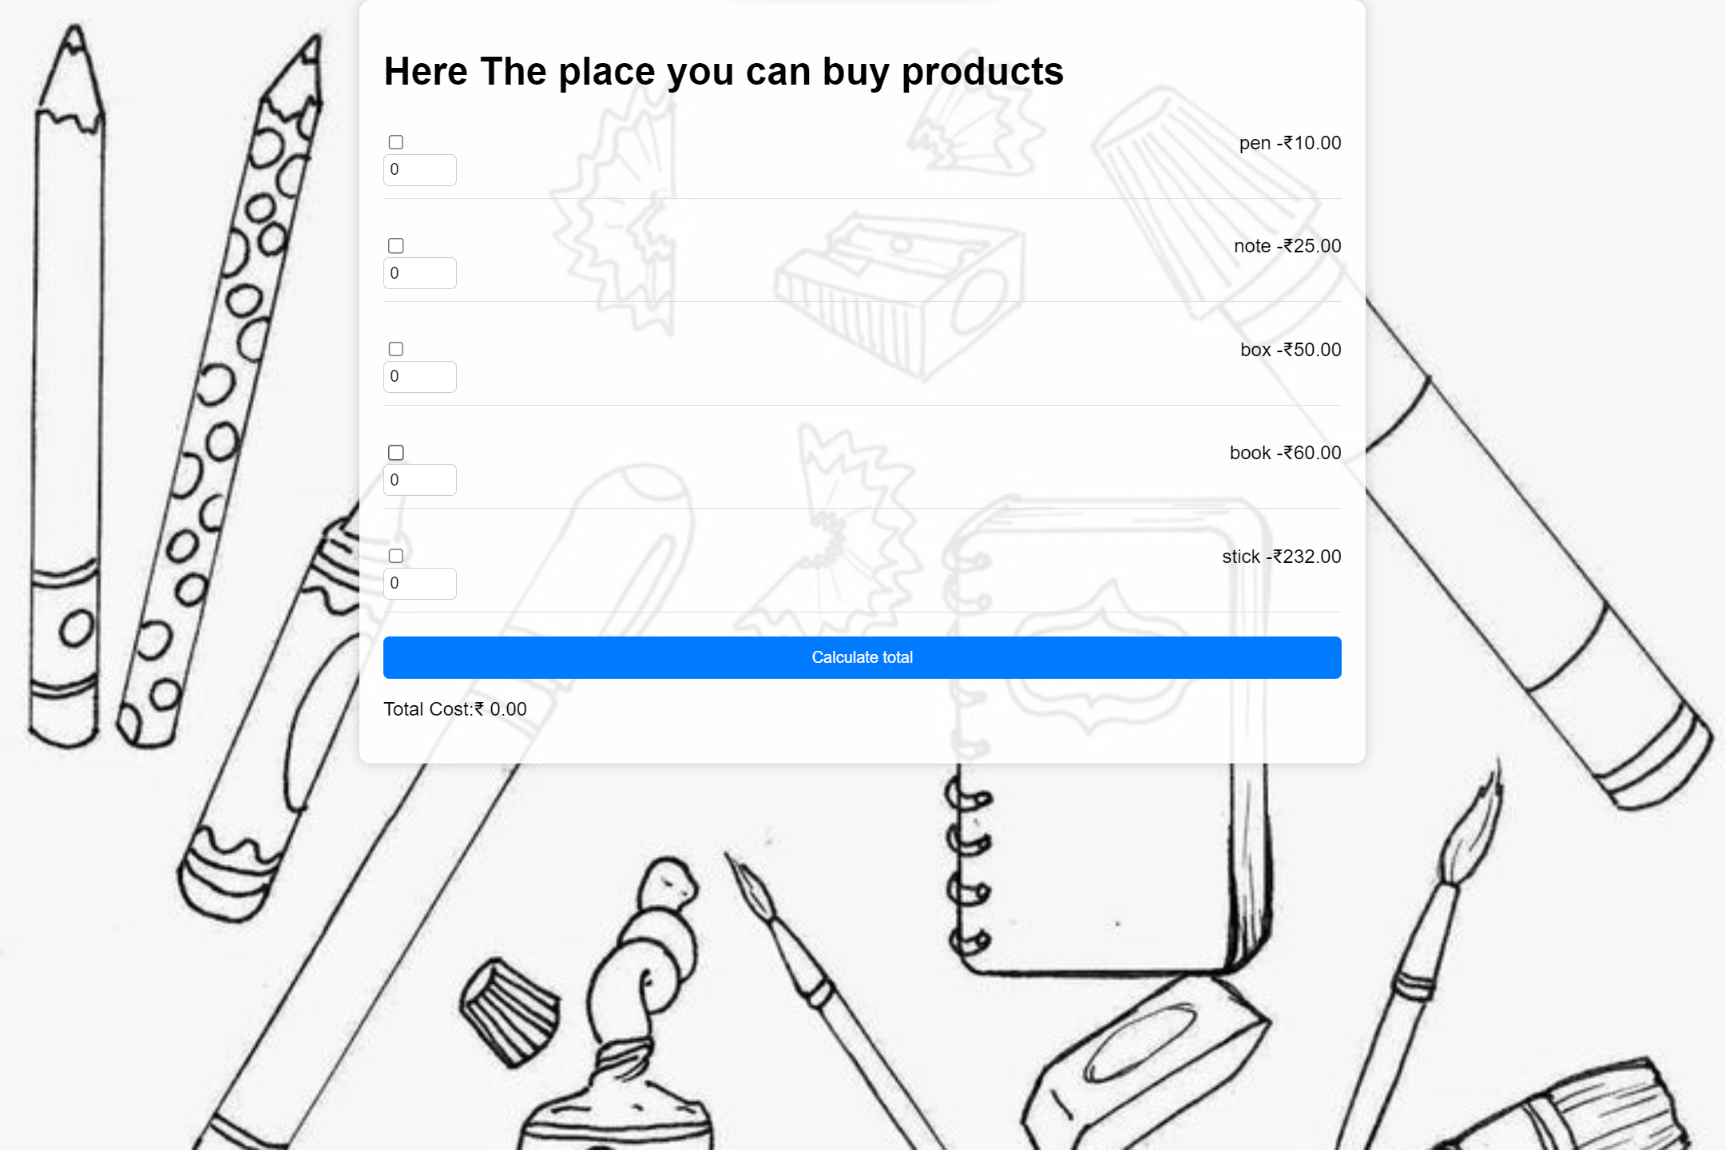

Slide 11
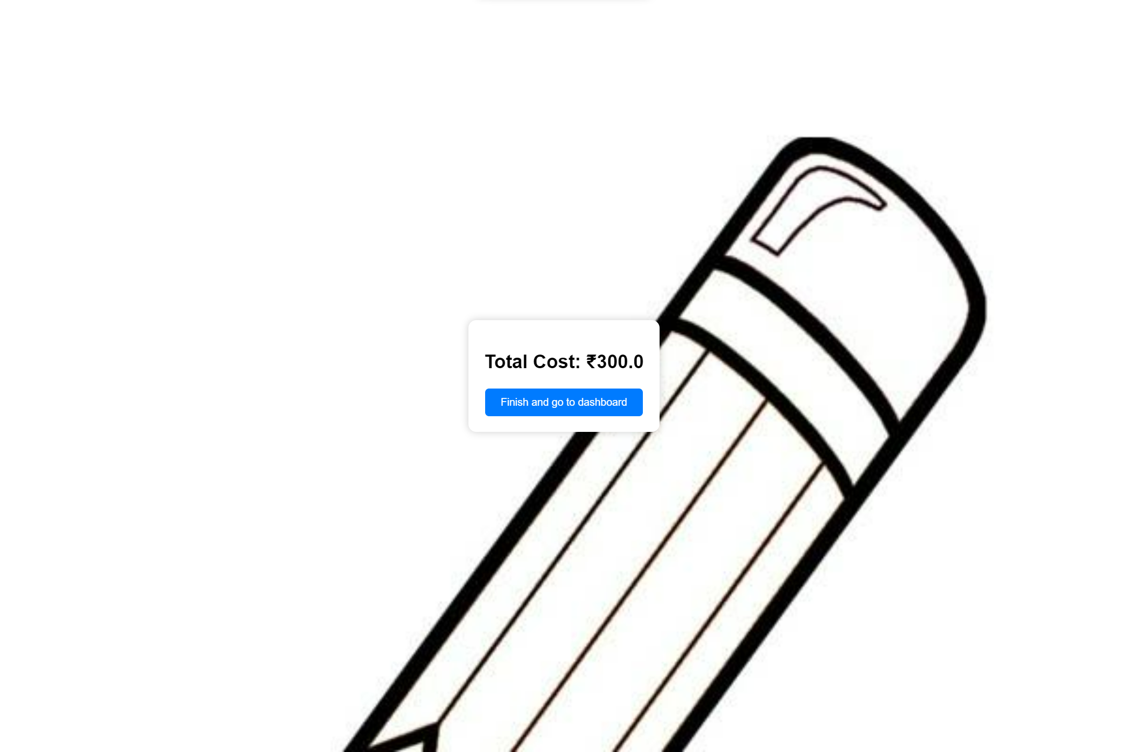

Slide 12
Select sell products
Click calculate
Click go to dashboard

Slide 13
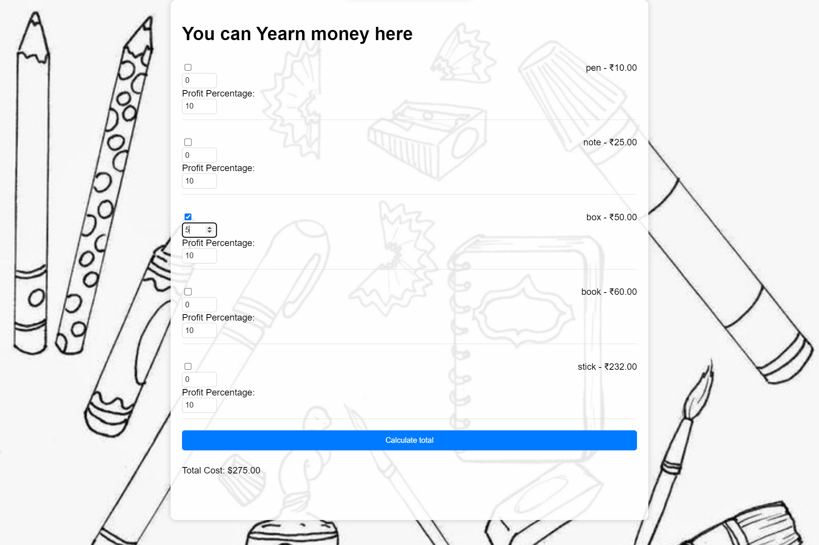

Slide 14


Slide 15
Select buy add items
Enter some item
Click go to dashboard

Slide 16
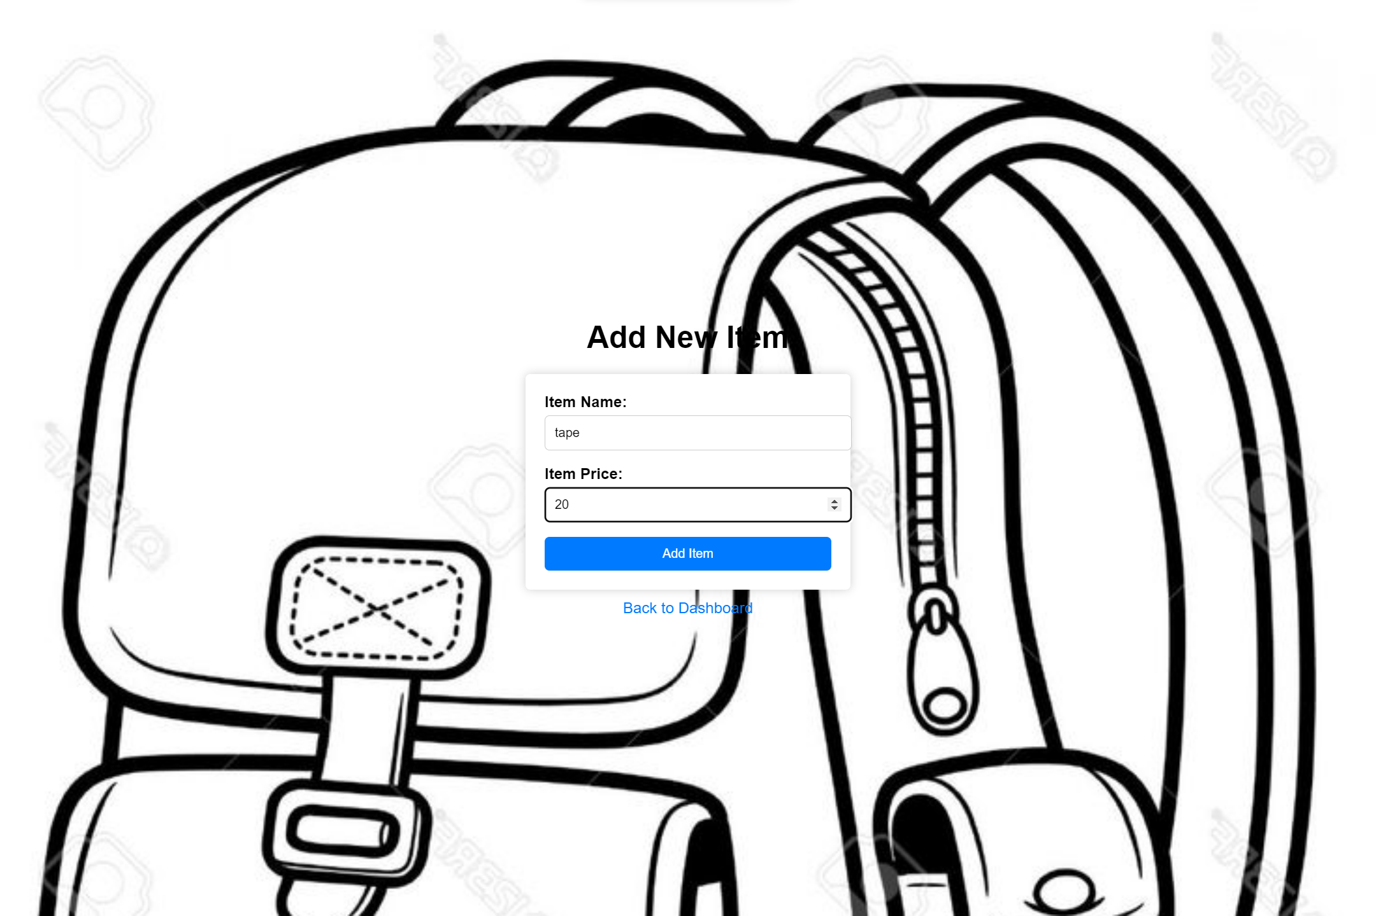

Slide 17
Select buy view items
You can view the list of items
Click go to dashboard

Slide 18
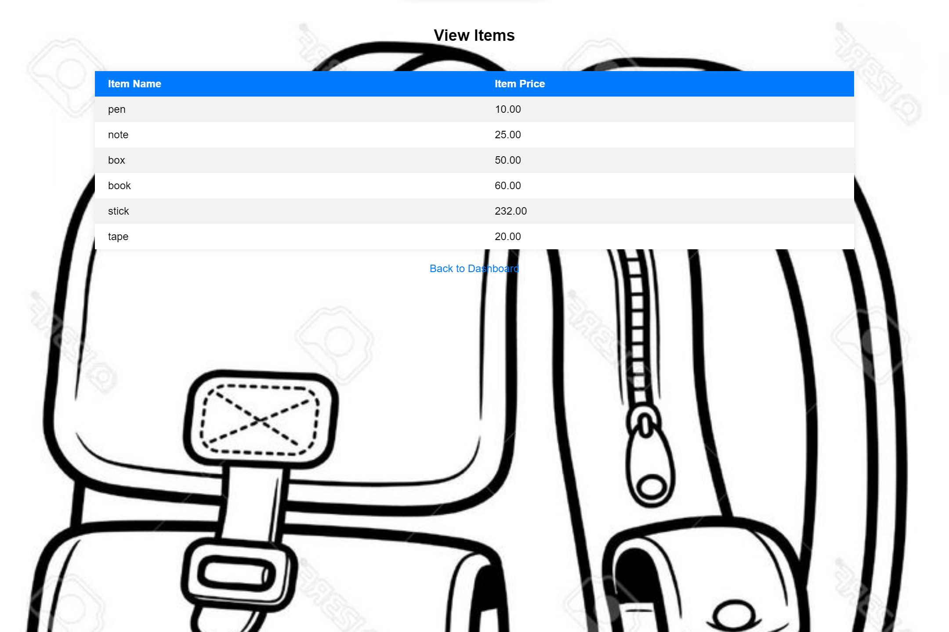

Slide 19
Select buy purchase history items
You can view the purchase history
Click go to dashboard

Slide 20
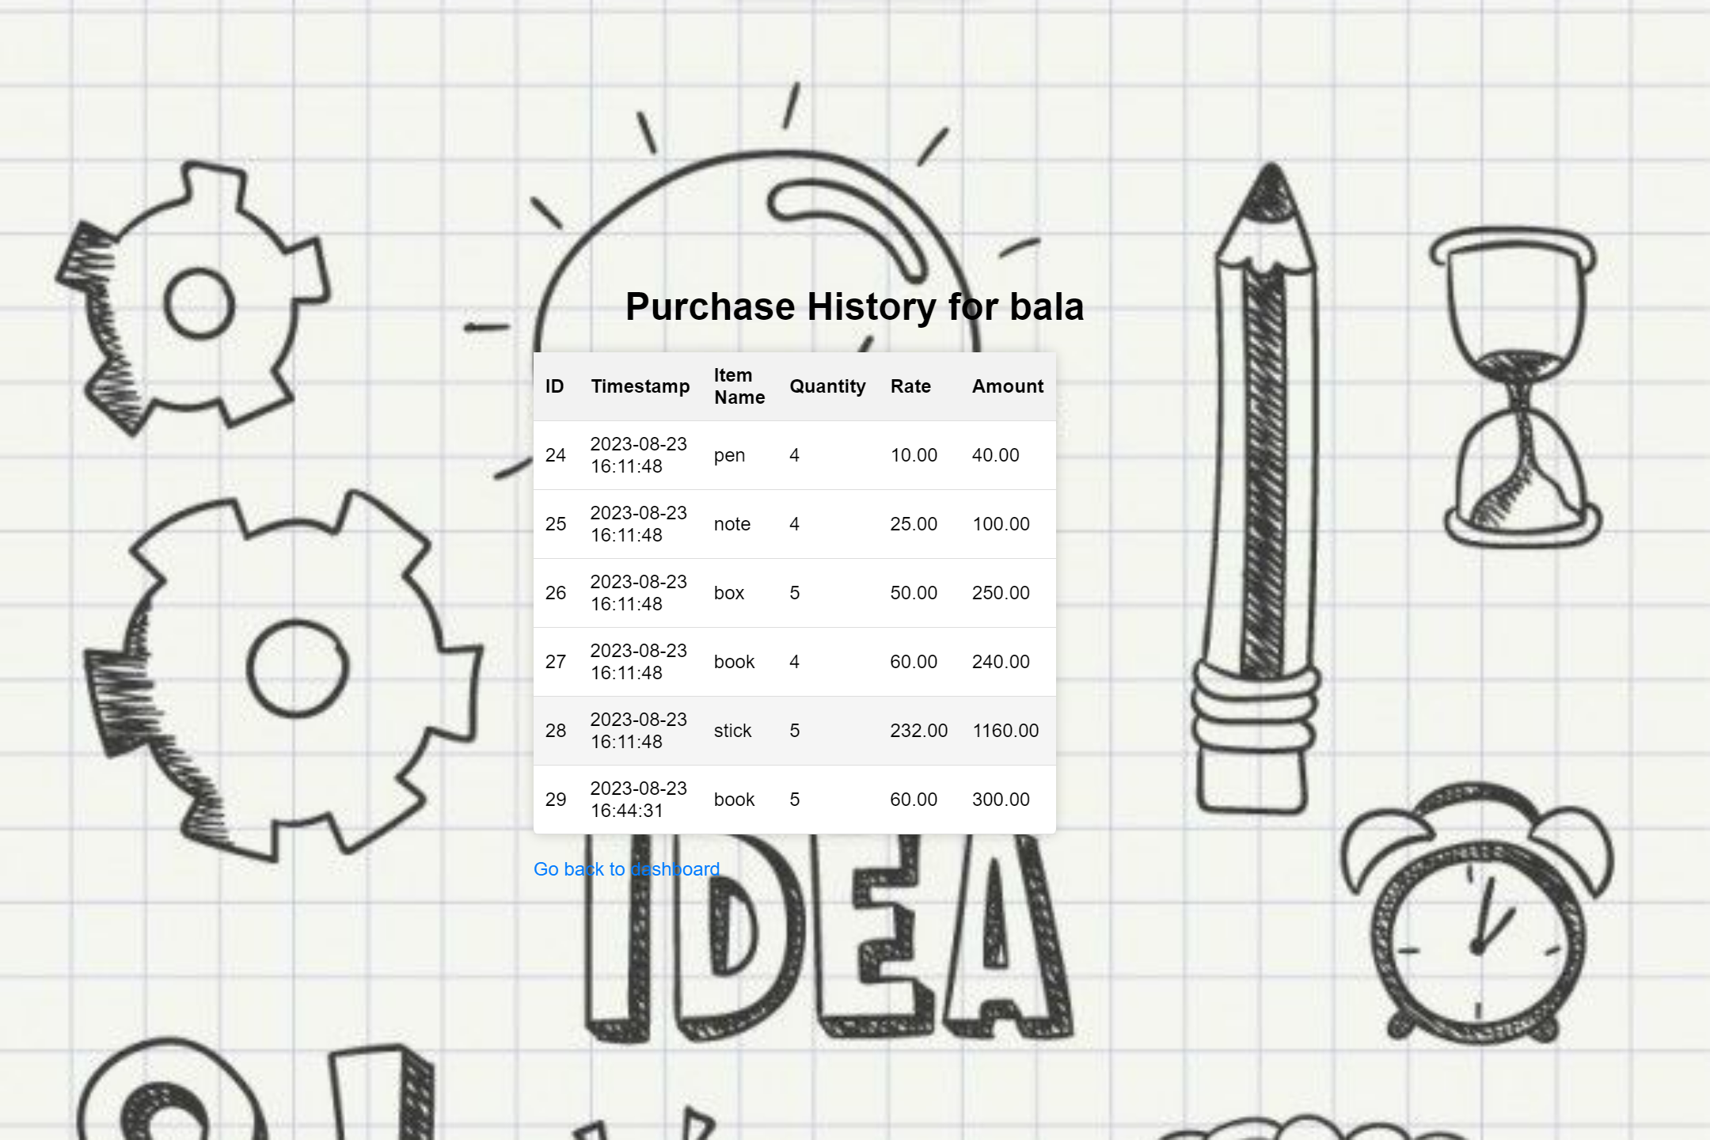

Slide 21
Select buy sold history items
You can view the sold history
Click go to dashboard

Slide 22
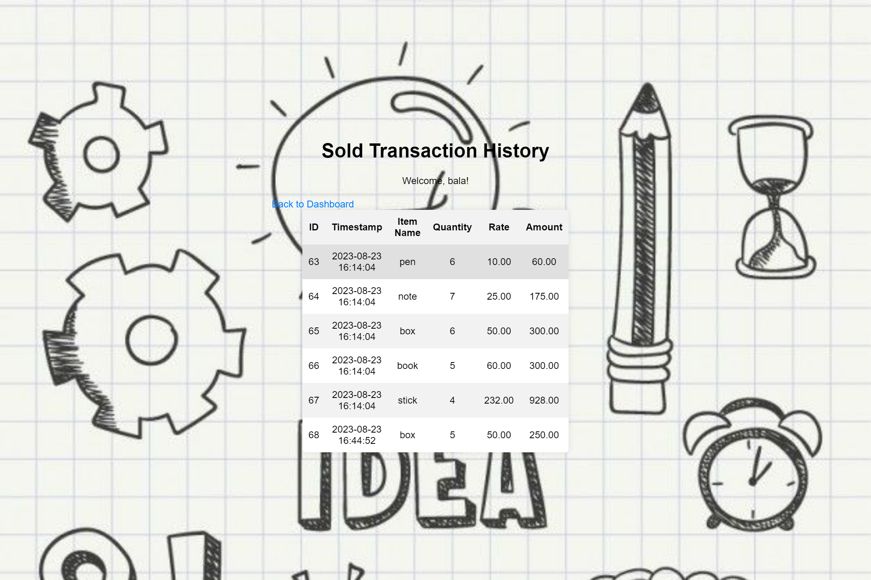

Slide 23
Select buy view balance
You can view the purchase history
Click go to dashboard

Slide 24
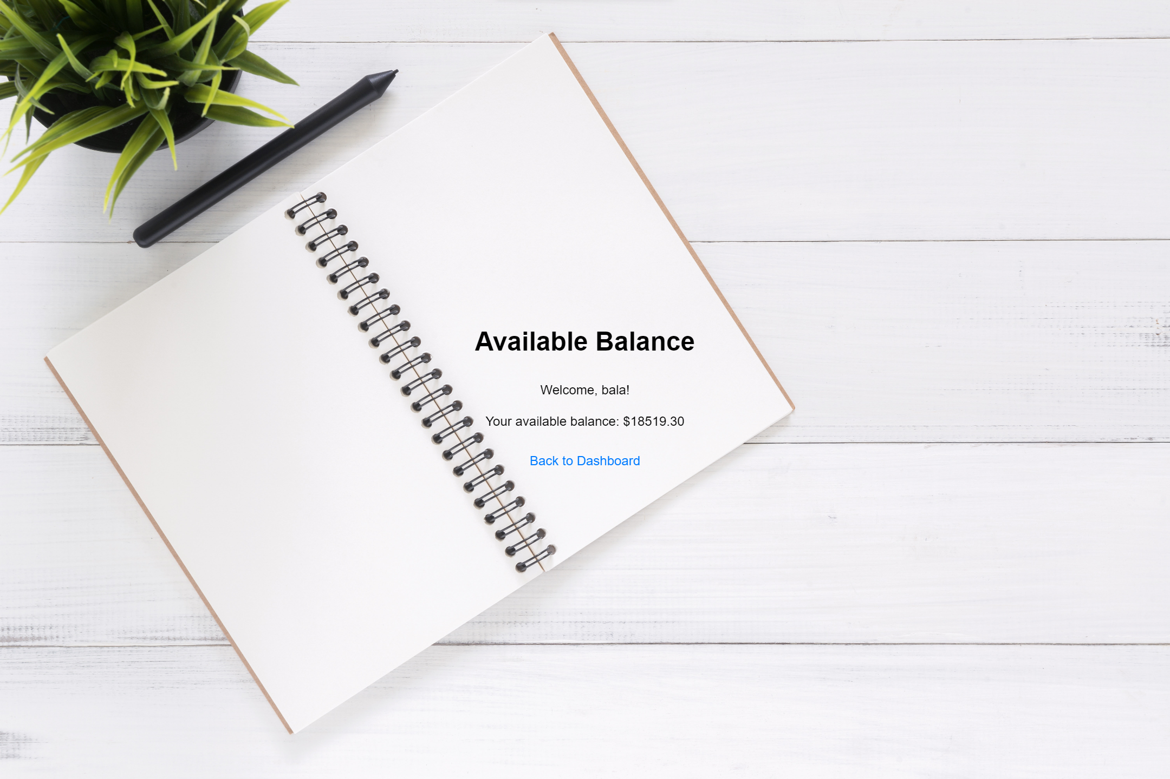

Slide 25
THANK YOU..

